Slide 1

SMART INDIA HACKATHON 2026
TITLE PAGE
Problem Statement ID – 26127
Problem Statement Title- City-Wide AI Engine for Multi-Camera ANPR Trajectory Tracking and Urban Traffic Analytics
Theme- Smart Automation
PS Category- Software/Hardware
Team ID-
Team Name - NeuraTrack

Slide 2














TRACE-X
AI-Powered Vehicle Tracking & Traffic Intelligence
Neura
Track
TRACE-X Solution Pipeline
Real-World Challenges
Illustrative Vehicle Journey Example (Multi-Camera Tracking)
!
CCTV cameras see vehicles, but connecting them across the city is difficult.
Multi-Stage Intelligence with Trust-Aware Evidence Modelling
Connecting imperfect evidence to reconstruct a probable journey
Blurred / Unreadable Number Plates
City-Wide CCTV Network
External Data Sources
Cam-101
10:00
Cam-205
10:04
Cam-317
(Offline)
Cam-422
10:12
Low resolution, motion blur, dirty or damaged plates.
Road Network
(OpenStreetMap)
Adverse Conditions
Cam-101
TS09AB1234
TS09A?1234
TS09AB1234
Night, rain, glare, lighting changes.
1. Video Ingestion
Camera Metadata
(location, direction)
OCR Conf.: 0.96
Appearance: White SUV
Direction: East → West
OCR Conf.: 0.43
Appearance: Similar
Direction: East → West
No observation
(Camera unavailable)
OCR Conf.: 0.91
Appearance: Match
Direction: East → West
CCTV / RTSP / Recorded Videos
Partial Occlusion
Cam-205
2. AI Perception
Observed
Observed (Partial)
Unknown
Observed
Vehicles blocked by other vehicles, buses, trucks or pedestrians.
Vehicle & Plate Detection • OCR
Vehicle Attributes • Re-Identification
3. Evidence Analysis
Historical Data
(traffic patterns)
Observed
Cam-317
Image Quality • OCR Confidence
Camera Reliability • Attribute Matching
C205
10:04
C317
(Offline)
C422
10:12
Inferred (Probable)
Different Viewpoints
Unknown (No Data)
4. Journey Reconstruction
Contradicted (Rejected)
Same vehicle looks different across cameras (front, back, side).
Spatial-Temporal Validation
Road Network Constraints • Multi-Hypothesis Tracking
Watchlist
(authorized)
Cam-422
5. Verification & Explanation
TRACE-X Research & Innovation Layer
Missing Observations
⋮
Contradiction Detection
Confidence Estimation • Observed / Inferred / Unknown
Beyond detection – towards trustworthy vehicle intelligence
Camera outages, network issues, maintenance periods.
6. City-Level Intelligence
Traffic Analytics • OD Matrix • Alerts & Watchlist
GIS Visualization • Reports
◎
Evidence-Driven
Camera Selection
✓
Uncertainty-Driven
Adaptive Processing
!
Explainable
Results
False Visual Similarity
✓
Confidence-Aware
Evidence Modelling
±
Positive +
Negative Evidence
!
Contradiction
Detection
⋔
Multi-Hypothesis
Journey Reconstruction
Different vehicles may look similar (same make, colour, model).
Finds the most useful next cameras to reduce uncertainty.
Focuses more compute on uncertain events.
Shows why a journey is considered likely or unlikely.
Uses image quality, OCR confidence, camera reliability.
Uses both detections and missing observations.
Rejects physically impossible transitions (time, distance, direction).
Maintains multiple possible routes.
A single camera detection is an observation,
not a trustworthy vehicle identity.

Slide 3
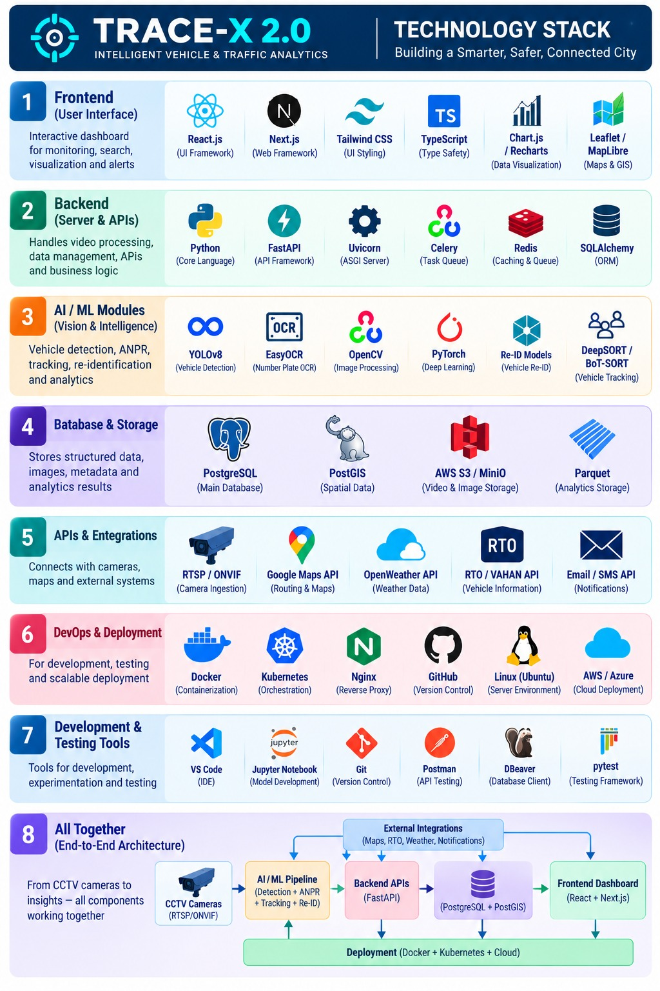
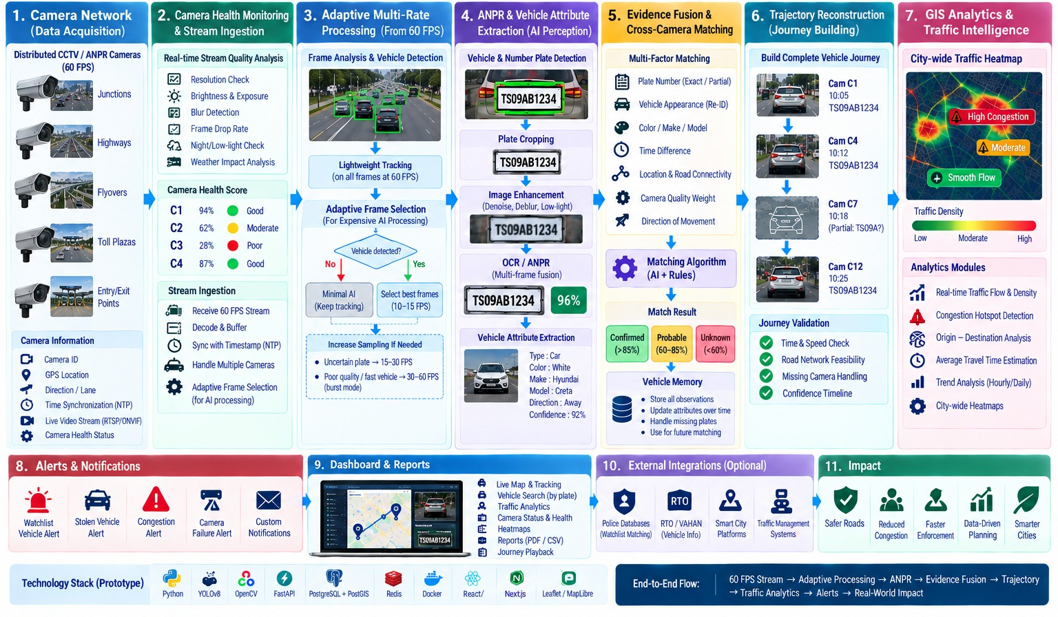
TECHNICAL APPROACH
Neura
Track

Slide 4













FEASIBILITY AND VIABILITY
Neura
Track
FEASIBILITY ANALYSIS
VIABILITY
BUSINESS POTENTIAL
Infrastructure Reusability:
Builds on existing CCTV/ANPR camera networks — no new hardware installation required.
Proven Concept:
Mirrors AI traffic-surveillance systems already live in major Indian cities.
Government Cost Savings:
Automates manual monitoring, cutting personnel hours and cost.
Scalable Deployment:
Pilot at a few key intersections first, then expand citywide zone-by-zone.
Builds Public Trust:
Automated, timestamped detection minimizes bias and gives auditable evidence.
New Revenue Generation:
OCR output integrates with e-challan systems for automated fines.
Cost-Effectiveness:
Open-source CV stack keeps setup cost low versus proprietary ANPR systems.
Authority Engagement:
Real-time dashboards keep control-room operators actively in the loop.
Faster Vehicle Recovery:
Cross-camera trajectory search cuts investigation to minutes.
Authority Integration:
Blacklist alerts, case management, and manual override for police control.
Guarantees Accountability:
Every detection, alert, and case action is logged and traceable.
Multi-City Scalability:
Same architecture licenses to other cities with local config only.
Data Readiness:
Police FIR records and camera metadata plug directly into the registry and blacklist.
Regulatory Alignment:
Fits existing FIR-linked enforcement and investigation workflows, no new legislation needed.
Analytics as a Product:
Aggregated data supports signal timing and infra planning.

Slide 5
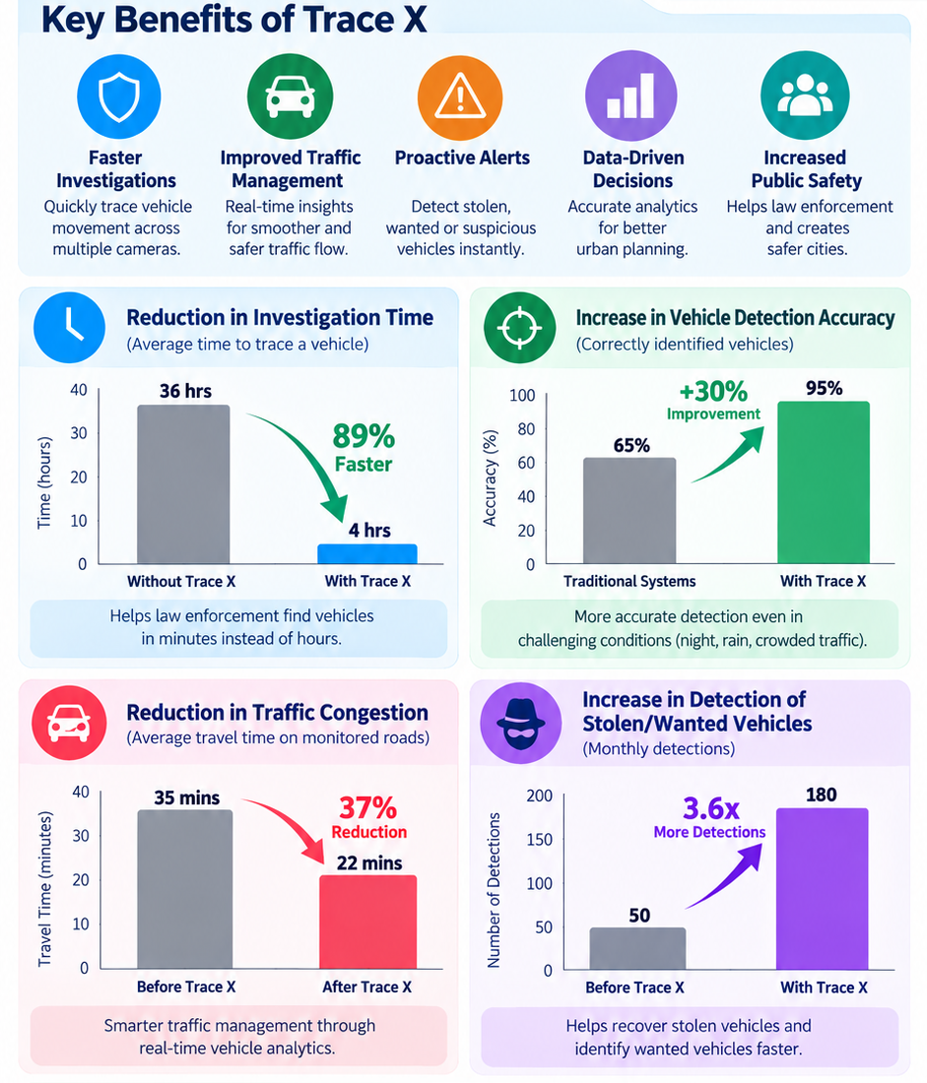
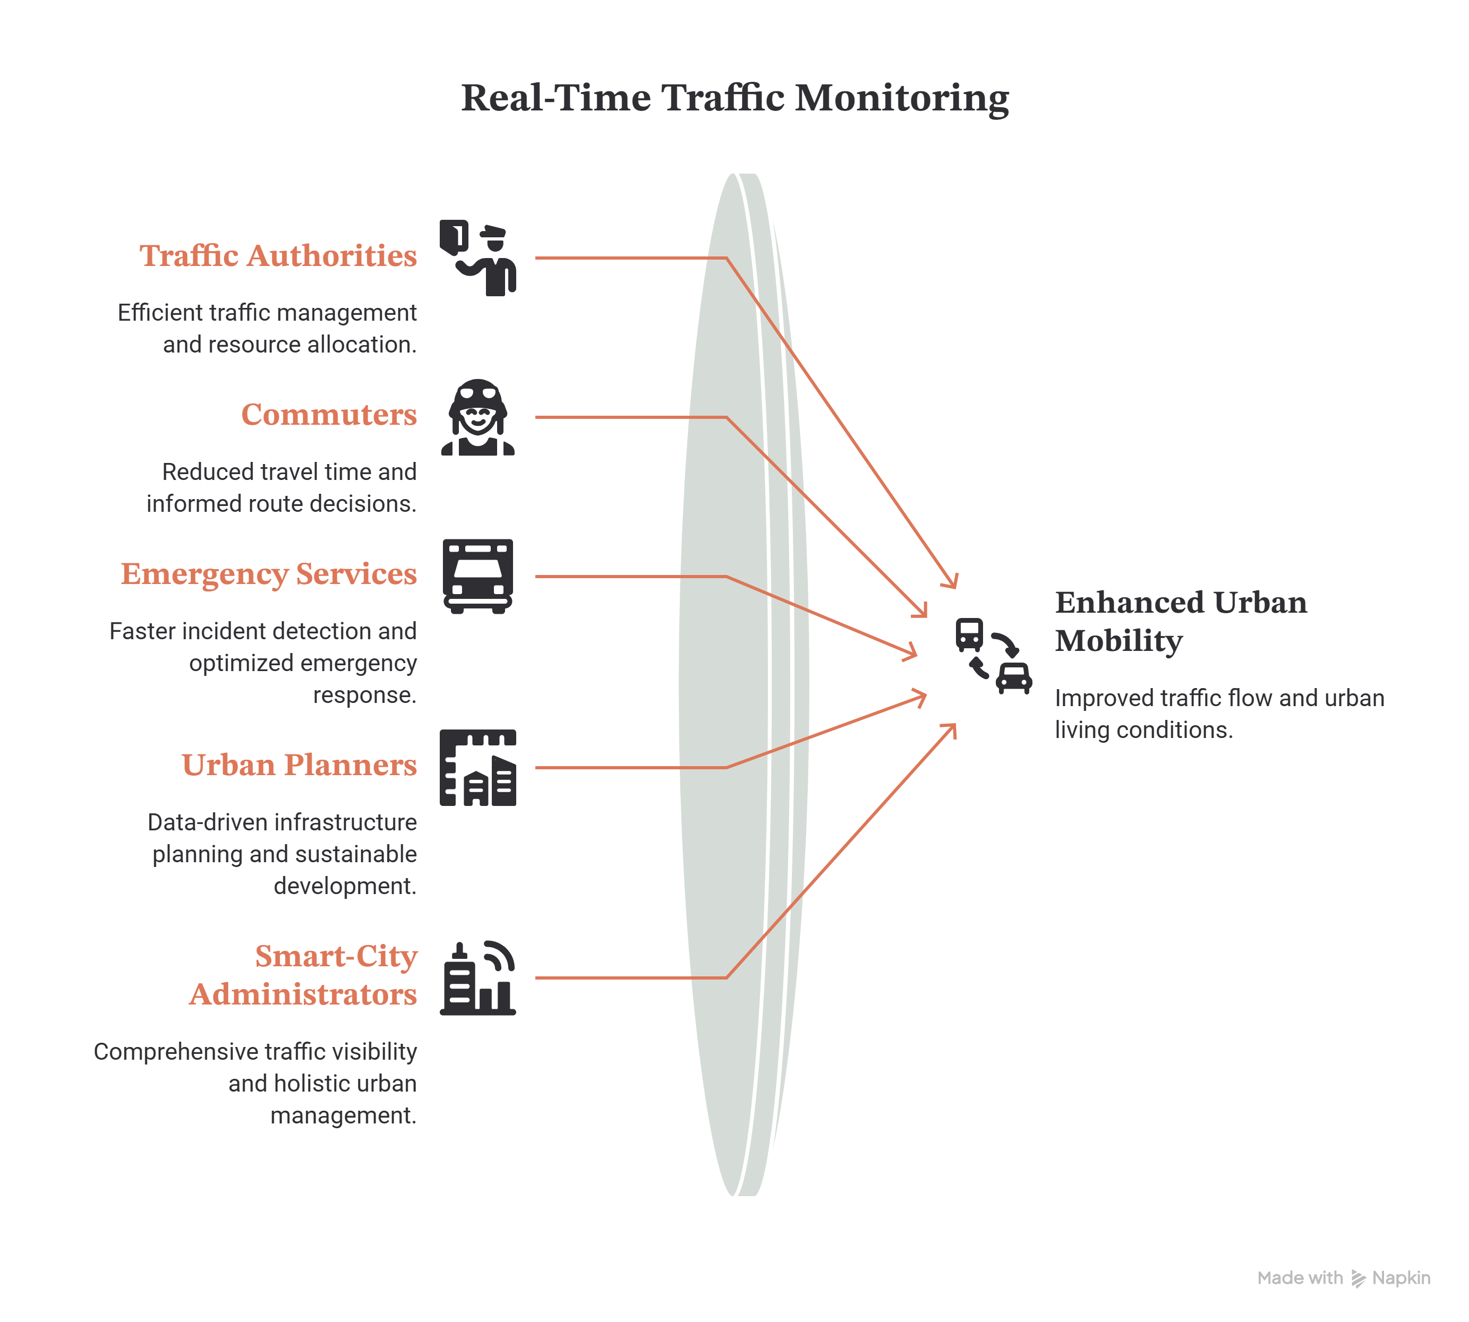
IMPACT AND BENEFITS
Neura
Track
Impact on Target Audience
Traffic Authorities: Real-time congestion and incident monitoring.
Commuters: Reduced travel time and better route decisions.
Emergency Services: Faster detection and response to incidents.
Urban Planners: Data-driven traffic and infrastructure planning.
Smart-City Administrators: City-wide traffic visibility from existing CCTV.

Slide 6
RESEARCH AND REFERENCES
Neura
Track
2 TRACE-X RESEARCH EXTENSION
1 RESEARCH BASE
Indian ANPR • 2022
1
A. Confidence-aware evidence
Indian plate diversity makes direct transfer from non-Indian datasets difficult.
Every observation carries OCR, image-quality and camera-health confidence.
Multi-Camera Tracking • 2019
2
B. Multi-hypothesis journey
Visual + orientation + spatial-temporal cues improve vehicle tracking across cameras.
Keep competing routes instead of forcing one vehicle path when evidence is ambiguous.
City-Scale MCT • 2021
3
C. Negative + contradictory evidence
Re-ID + track matching + spatial-temporal information support city-scale traffic management.
Represent expected-but-unseen observations and reject physically inconsistent transitions.
Intelligent Camera Selection • 2022
4
D. Evidence-driven camera selection
Camera-selection policies can reduce unnecessary Re-ID queries and computation.
Choose the next camera/time-window by expected information gain, not only proximity.
3 VALIDATION FOUNDATION
Hyderabad CCTV
City-scale benchmark
Indian ANPR
Road network
IITH_Helmet2 / IITH_Accident
CityFlow / AI City
Indian plate dataset + BARC study
OpenStreetMap for GIS topology

